Slide 1







WHEEL OF FORTUNE
By: Adam, Jonathan, Dalton, Lucas and Grace

Slide 2
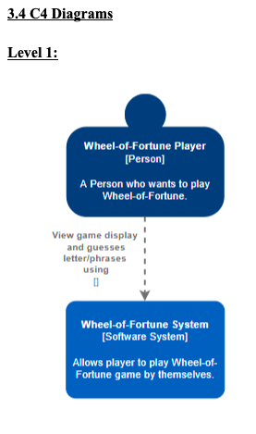
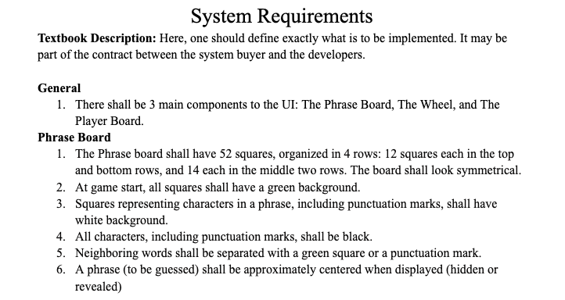
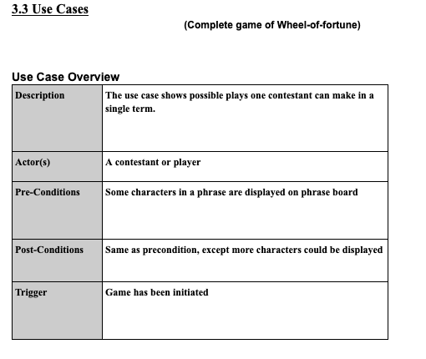
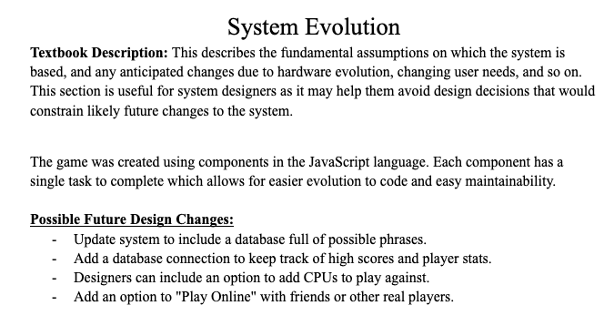
REQUIREMENTS DOCUMENT
Topics to go over:
Use Case
C4 Diagrams
System Requirements
System Evolution
https://docs.google.com/document/d/1DSQcaXha2LhyGTTUt_sKH3HQJKDPvmEV-Qo3NvQhWCU/edit

Slide 3


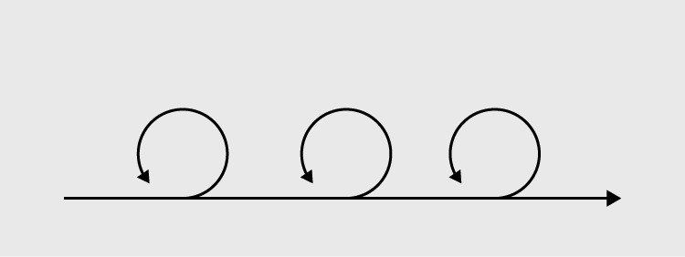
MEETINGS
Sprint Planning:
Agile development (iterative development)
Minimal documentation to upkeep
SCRUM:
Tasks
Visibility
Meetings:
Breakdown of tasks
Task assignment
Refinement
Weekly stand-ups
Questions and Concerns
Continual updating:
Discord
Trello
GitHub

Slide 4


COMMUNICATION
Discord:
Communicated via Discord
Different channels for different purposes
Asked questions
Posted announcements
Sent links and tutorials
Provided other resources
https://discord.com/channels/887884343471648768/887884343471648772
Trello:
Set up sprint planning environment
Created cards
Assigned people to cards
Set criteria, descriptions and potential due dates
https://trello.com/b/tVAb3Jqx/general-tasks

Slide 5
COLLABORATION/INDIVIDUAL WORK
Dalton
Wheel Display
Animation
Grace
Game Board
Jon
Letter Selection
Modal Pop-up
Adam
Documentation
Lucas
Player List
Troubleshooting

Slide 6
ISSUES/EVENTS
Development Issues
Lack of Javascript / React familiarity
Workload
Data binding

Slide 7



PROJECT OVERVIEW
Gatsby:
Developed in Gatsby
Website builder
Provided framework
React:
Coded in React
New and upcoming language
Bootstrap:
Formatted using bootstrap
Github:
Pushed changes on the Git command line
Contributed to individual branches
Kept track of version history

Slide 8
01
BOARD COMPONENT
02
LETTER BANK COMPONENT
03
PLAYER COMPONENT
04
ACTION LIST
05
WHEEL COMPONENT
06
MIGHT HAVE MISSED SOMETHING CAN GO HERE

Slide 9
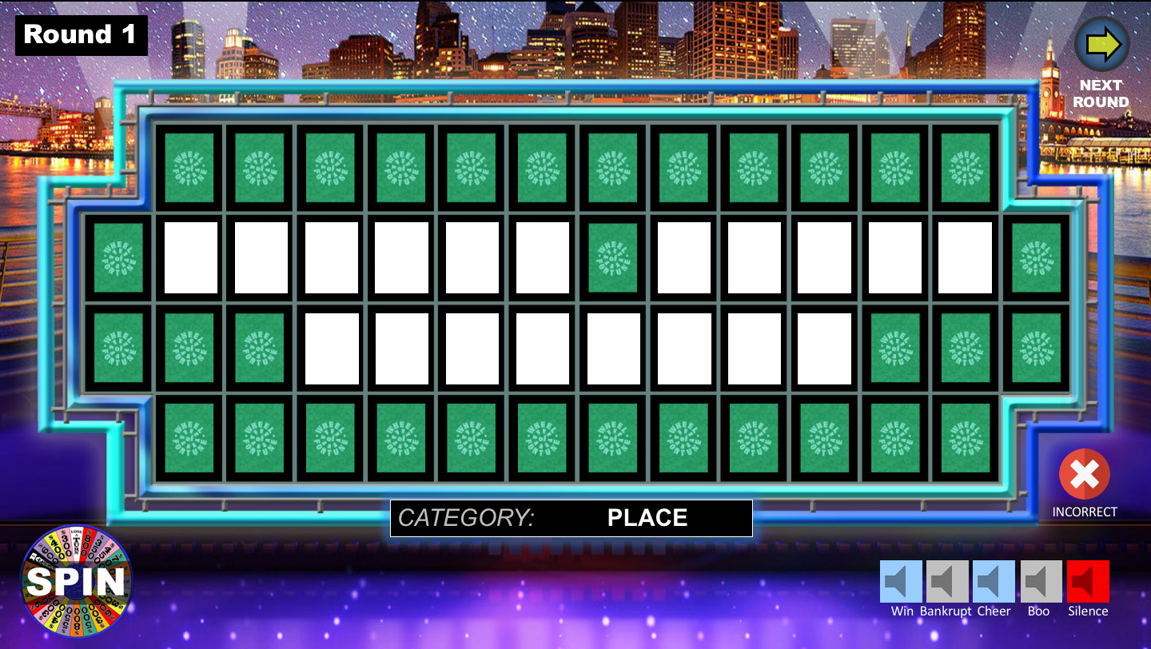
BOARD COMPONENT
Explanation:
Generate random phrase
Split by spaces
Split again by character
Generate square component per character
Slice array into two parts (row 1 and row 2)
Display ‘character’ based on a player’s guess
Development Process:
Isolated environment
Open end variables
Matched existing code (Bootstrap/functions)
Issues:
Board spacing/formatting
Code:
https://github.com/MakhairaGirlxX/wheel-of-fortune/tree/Board

Slide 10
LETTERBANK COMPONENT
Explanation:
A modal that pops up with letters that can be selected to guess if they are in the phrase.
Letters shown will be different depending on whether player is guessing vowels or consonants.
Component will pass the letter guessed to the phrase board to math against the generated phrase.
Development Process:
Utilizing React.js and Bootstrap to create a frontend component that can be interacted with through a web browser
Learning new things. Relying on more experienced members (Lucas, Dalton, Grace)
Issues:
New technologies presented issues I was not familiar with
Modal and variable passing could not be implemented due to my inexperience

Slide 11
PLAYER COMPONENT
Explanation
Component to display the names and funds available to each player
Allows for players to be added
Allows for funds to be added and withdrawn
Dynamically assigns colors to players in the list
Composed of Player subcomponents
Development process
Initial working react example
Coaching
Issues
Initial file organization
Workload / Life events
Data binding

Slide 12
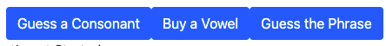
ACTION LIST
Explanation:
Generate 3 button choices per turn
Each button operates independently from one another
When pressed, each button enters loading stage
Allows user to know what button they pressed
System loads related action during this stage
Issues/Future Developments:
"Buy a Vowel" and "Guess the Phrase" not integrated with other components
Struggles with passing boolean states from component to component
One of the last features to add to game
Code:
https://github.com/MakhairaGirlxX/wheel-of-fortune/blob/main/src/Components/actions/actionList.component.js

Slide 13
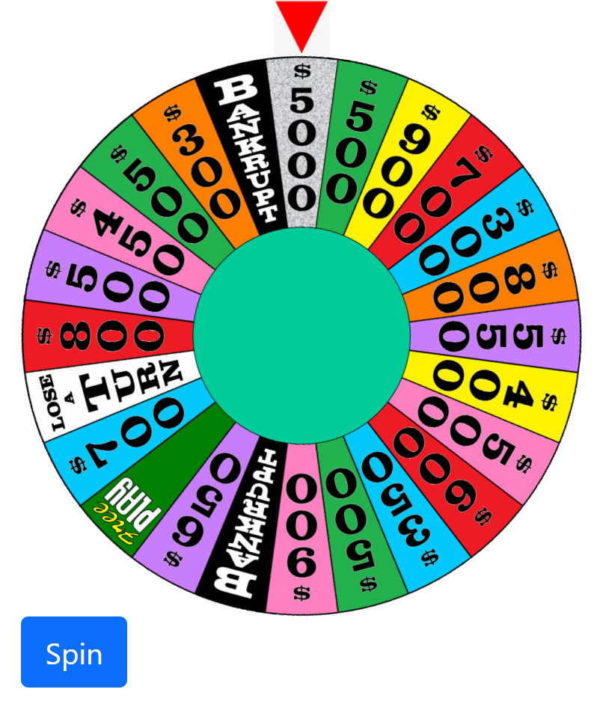
WHEEL COMPONENT
Explanation:
Display wheel image
Spun by clicking “Spin” button
Randomly selects an unused spot
Animation of wheel spinning
Spin button locks until allowed to spin again
Passes data of selected spot to other components
Development Process:
Isolated environment
Open end variables
Issues:
Displaying images
Animating
Passing data to & from the Wheel component
Code:
https://github.com/MakhairaGirlxX/wheel-of-fortune/blob/main/src/Components/wheel.component.js

Slide 14
FINAL PRODUCT
https://github.com/MakhairaGirlxX/wheel-of-fortune

